Slide 1
Fragmented growth areas
South-East Queensland
Dr Geoff Anstey MPIA
Land Supply Insight
2025 PIA Qld Conference – Toowoomba, 29 August 2025

Slide 2
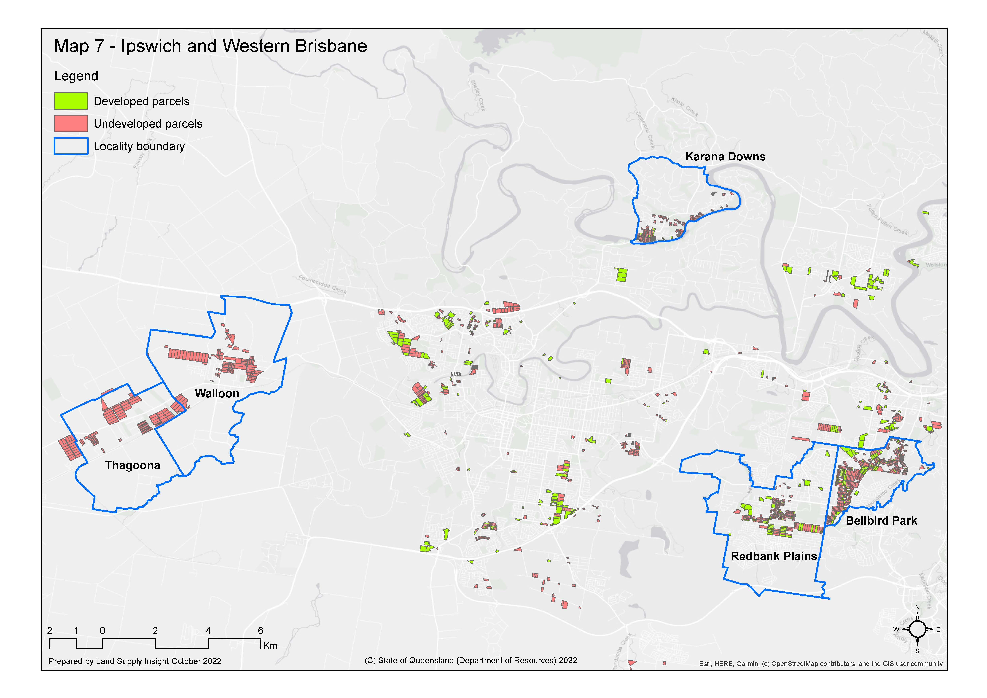
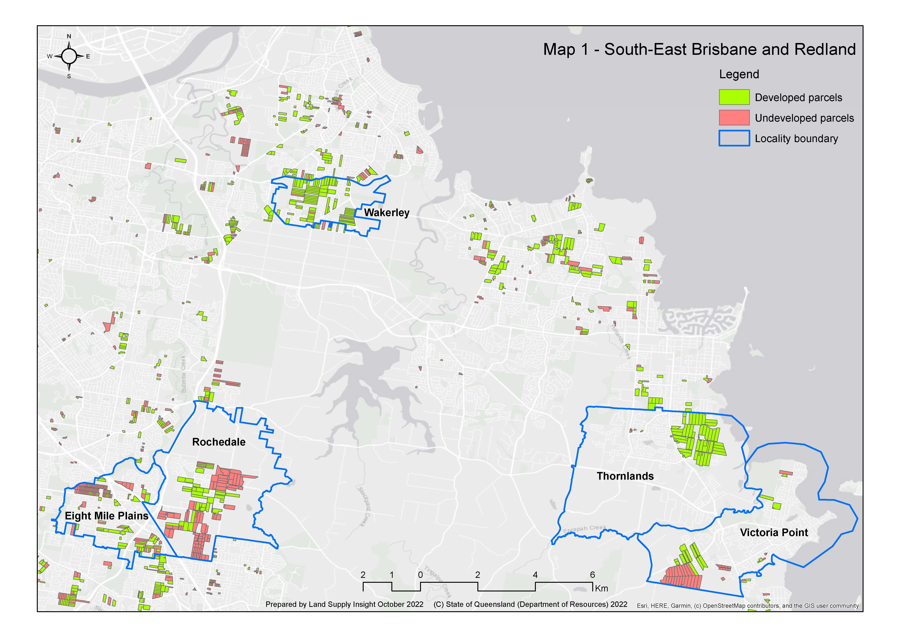
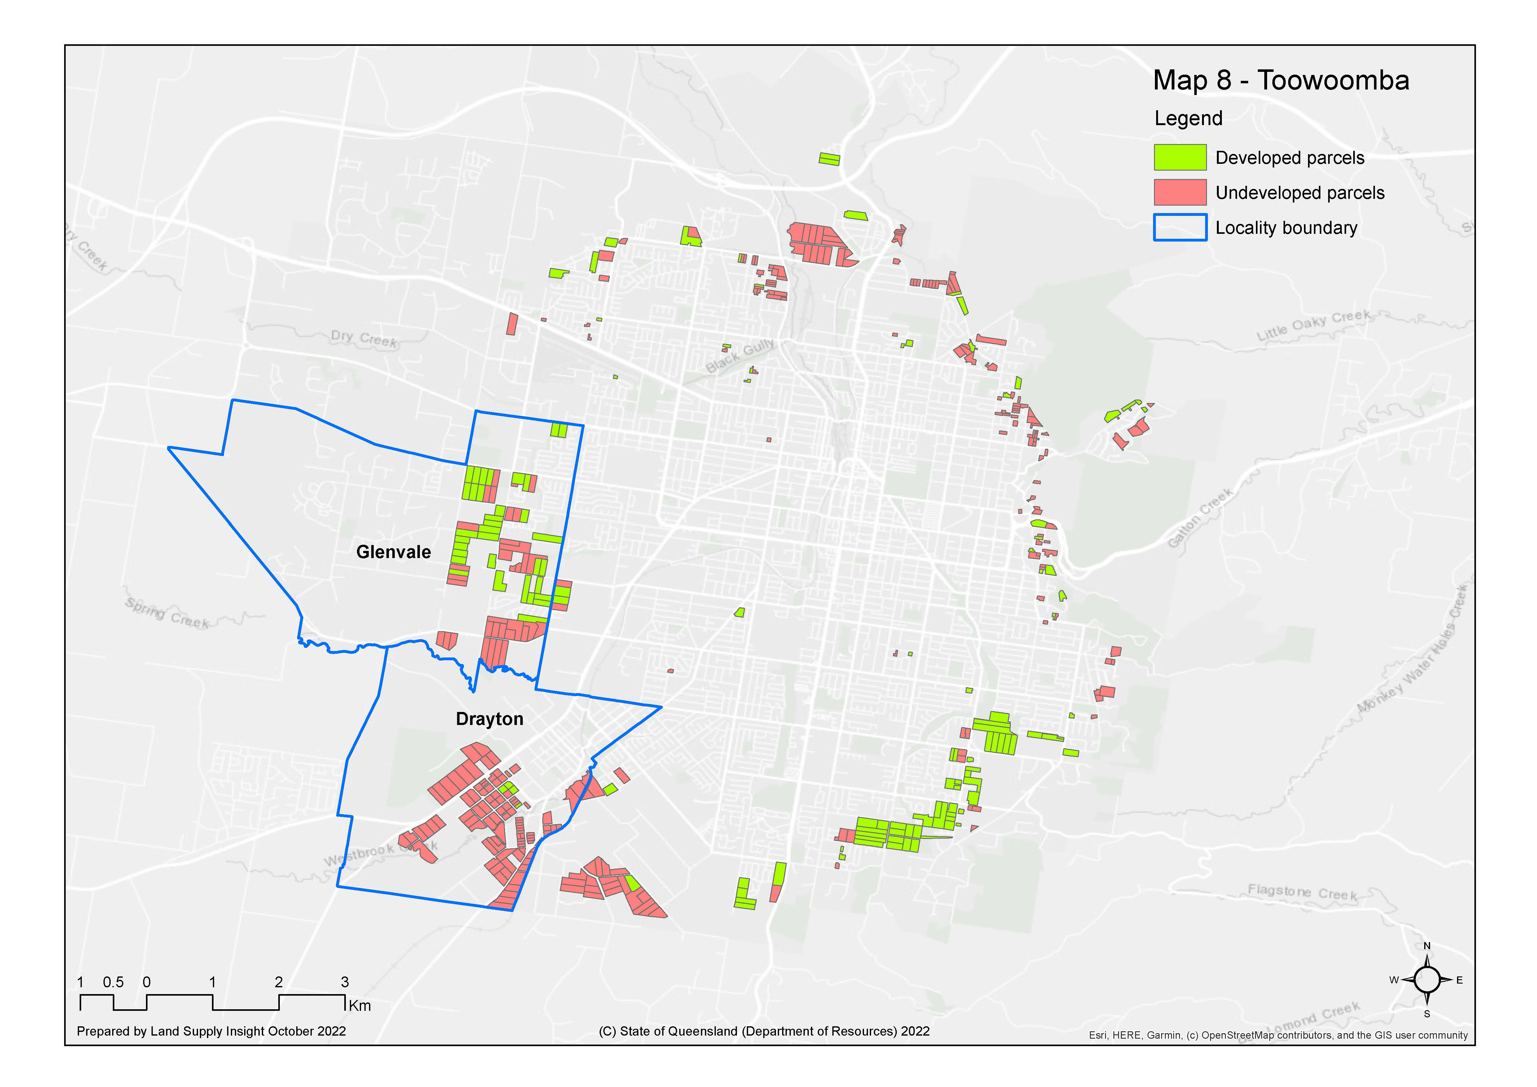
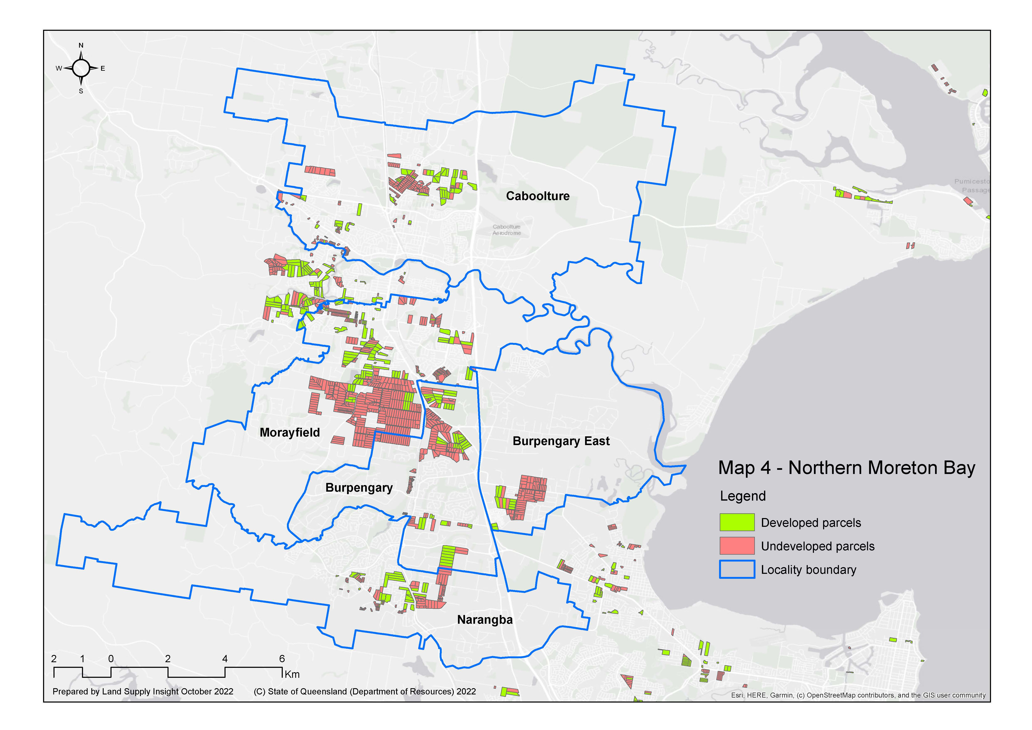
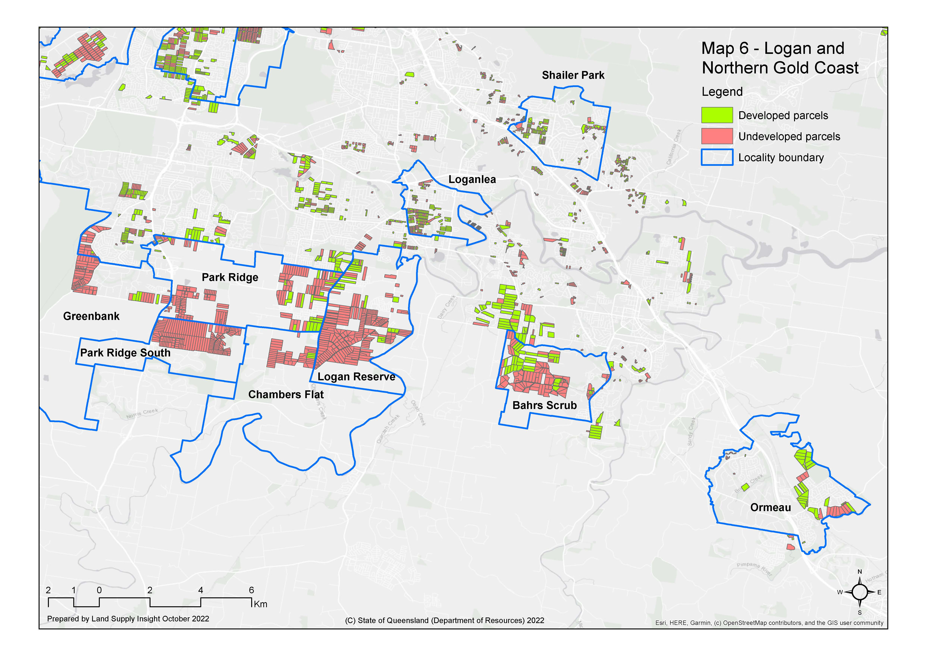
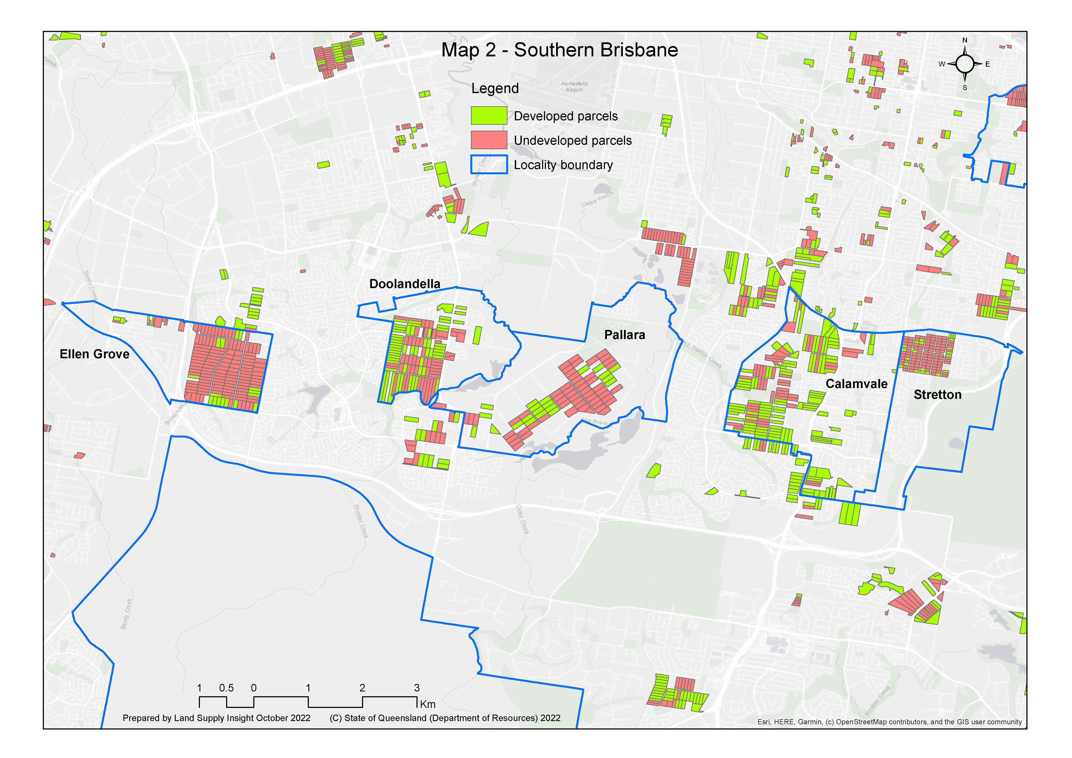
SEQ-wide analyses
Fragmented areas planned for urban growth:
  fragmented areas are parcels 0.25 < 5 ha
  19% of land in SEQ vs 8% in Melbourne (as at June 2022)
  12,390 ha in 10,573 parcels with average area 1.2 ha (as at July 2001)
  43% (by area) developed up to August 2022

Slide 3
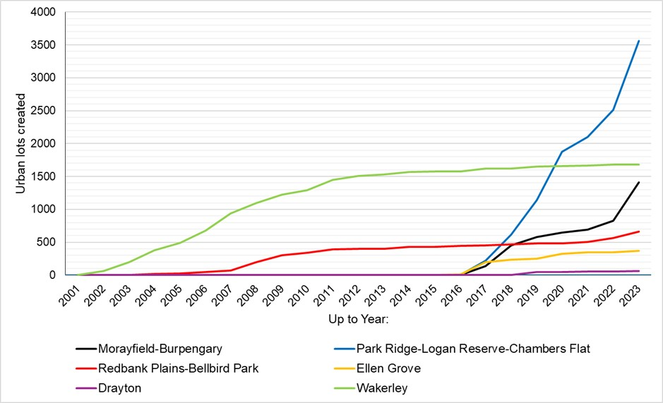
Case study areas overview
six case study areas - varying development stages, parcel sizes, infrastructure availability and accessibility
each more than 100 ha
overall potential - of order of 20,000 dwellings
80% in two largest areas:
  Morayfield-Burpengary (Moreton Bay)
  Park Ridge-Logan Reserve-Chambers Flat (Logan)

Slide 4
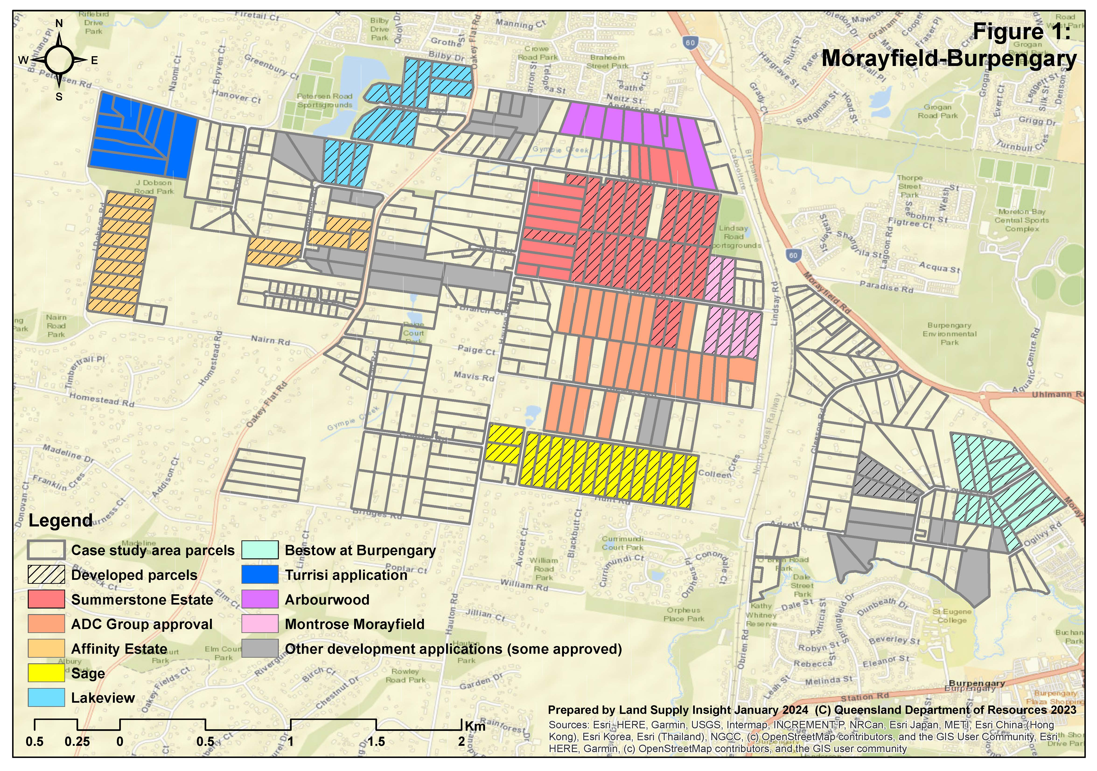
Morayfield-Burpengary
382 parcels (July 2001):
ave. title area 1.7 ha
ave. developable area 1.4 ha (82% have 0.5 ha or more)
52% (by title area) developed, developing or proposed (Dec 2023)
Infrastructure availability:
none in Priority Infrastructure Area (PIA)
significant sewerage upgrades required
some developments delayed years to resolve
Development pattern:
seven with more than 10 original parcels
two with more than 20

Slide 5
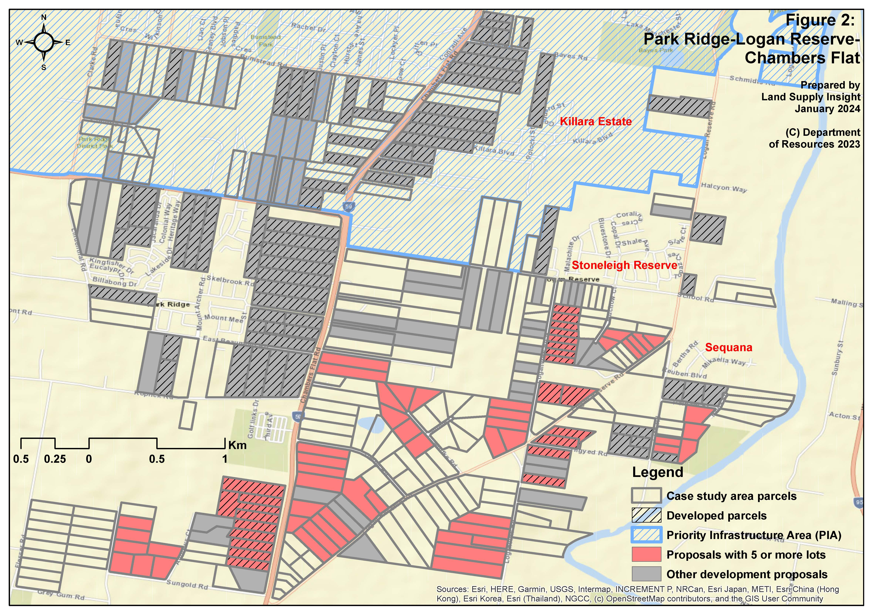
Park Ridge-Logan Reserve-Chambers Flat
348 parcels (July 2001):
ave. title area 2.4 ha
ave. developable area 1.8 ha (92% have 0.5 ha or more)
58% (by title area) developed, developing or proposed (Dec 2023)
Infrastructure availability:
part in PIA, but most not
facilitated by:
  sewerage provided for neighbouring developments
  upgrade to mains and pump stations along Chambers Flat Rd
Development pattern:
12 aggregations of five to nine parcels

Slide 6
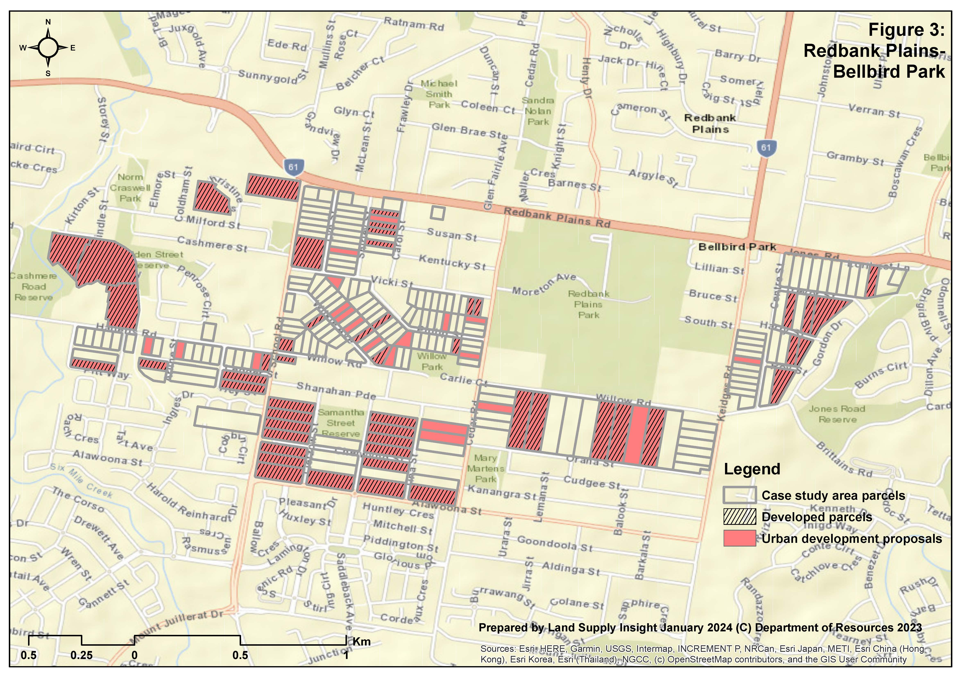
Redbank Plains-Bellbird Park
219 parcels (July 2001):
ave. title area 0.6 ha
ave. developable area 0.5 ha (71% have less than 0.5 ha)
48% (by title area) developed, developing or proposed (Dec 2023)
Infrastructure availability:
all in PIA since 2010
trunk sewerage mains serviced area since 2004
Development pattern:
high proportion (74%) of larger parcels (1 ha+) developed
most commonly only 1 or 2 original parcels in each development
smaller size of most parcels has constrained rate of development

Slide 7
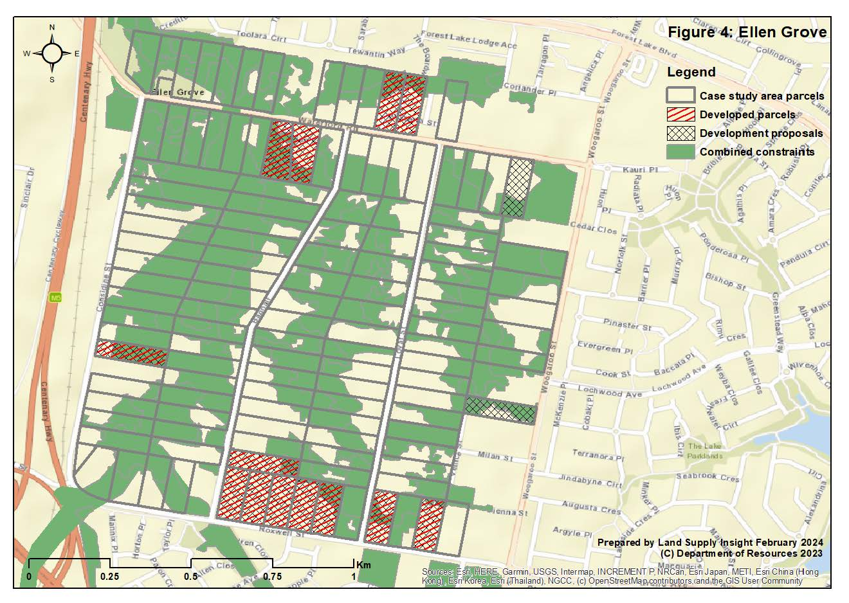
Ellen Grove
125 parcels (July 2001):
ave. title area 1.1 ha
ave. developable area 0.4 ha (62% have less than 0.5 ha)
11% (by title area) developed, developing or proposed (Dec 2023)
Infrastructure availability:
all in PIA since at least 2012
planned network of sewerage mains delayed over many years and now not in 2020 Netserv Plan
Development pattern:
developed parcels have generally larger developable areas and able to link into sewerage infrastructure in Forest Lake

Slide 8
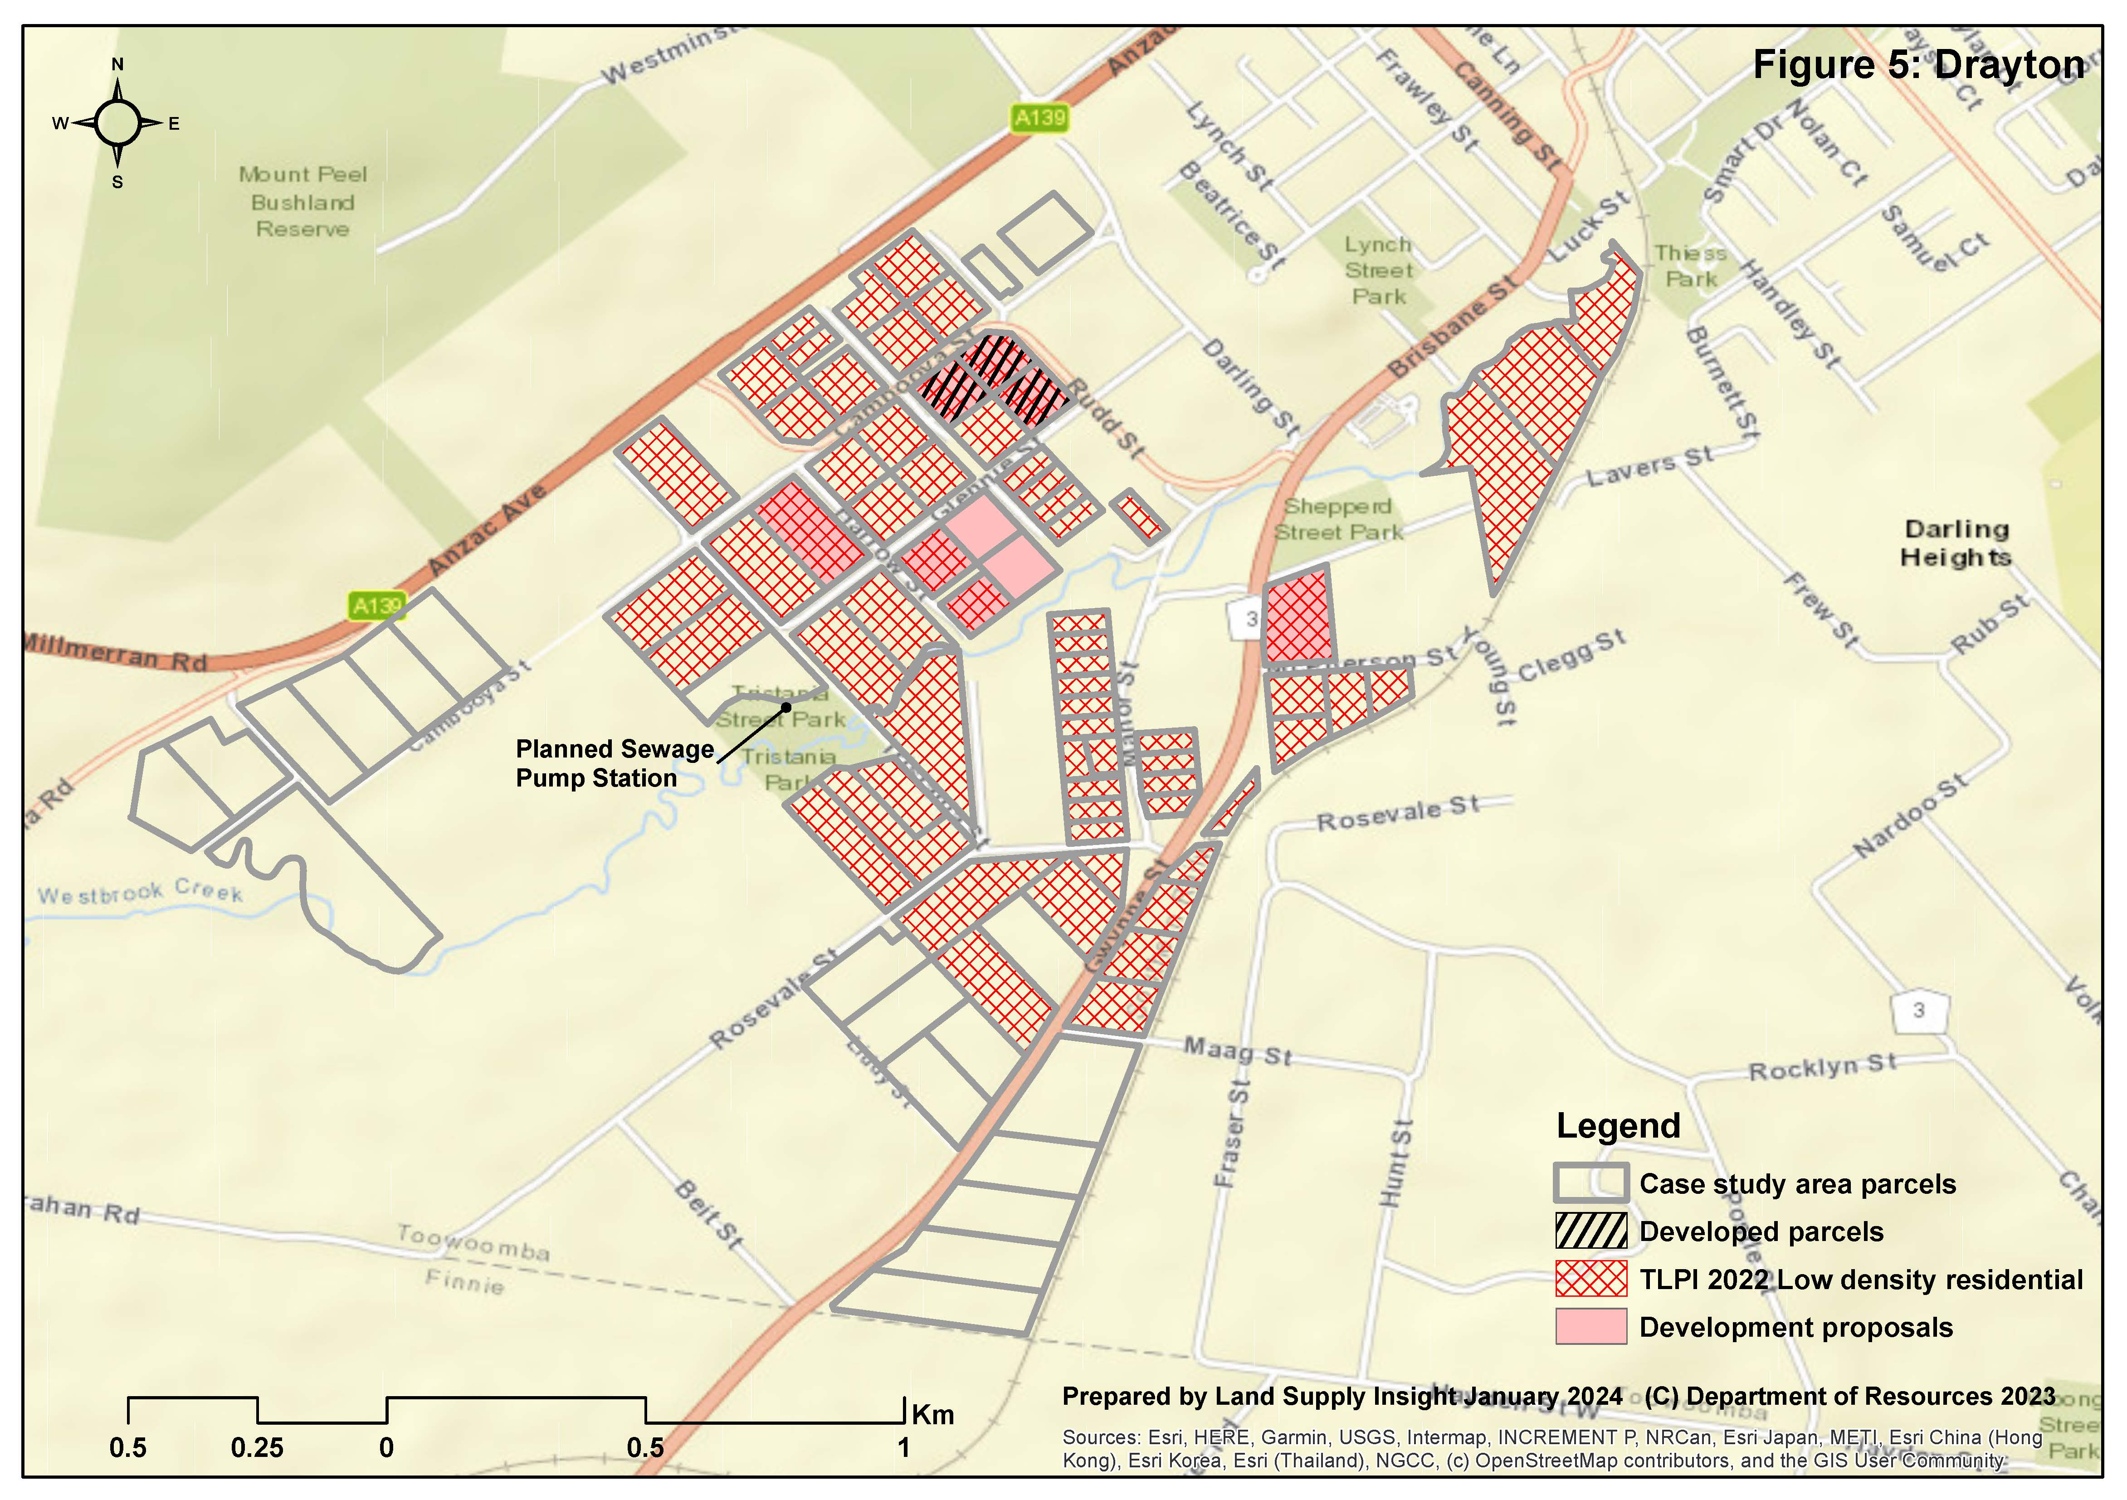
Drayton
88 parcels (July 2001):
ave. title area 1.3 ha
ave. developable area 1.3 ha (80% have 0.5 ha or more)
10% developed, developing or proposed (Dec 2023)
Infrastructure availability:
all in PIA since 2012
sewage pump station and rising mains planned to serve much of area delayed 10 years
Development pattern:
three upstream parcels developed in 2018 able to link into existing sewerage infrastructure
downstream development proposals (preliminary approval) delayed since 2016

Slide 9
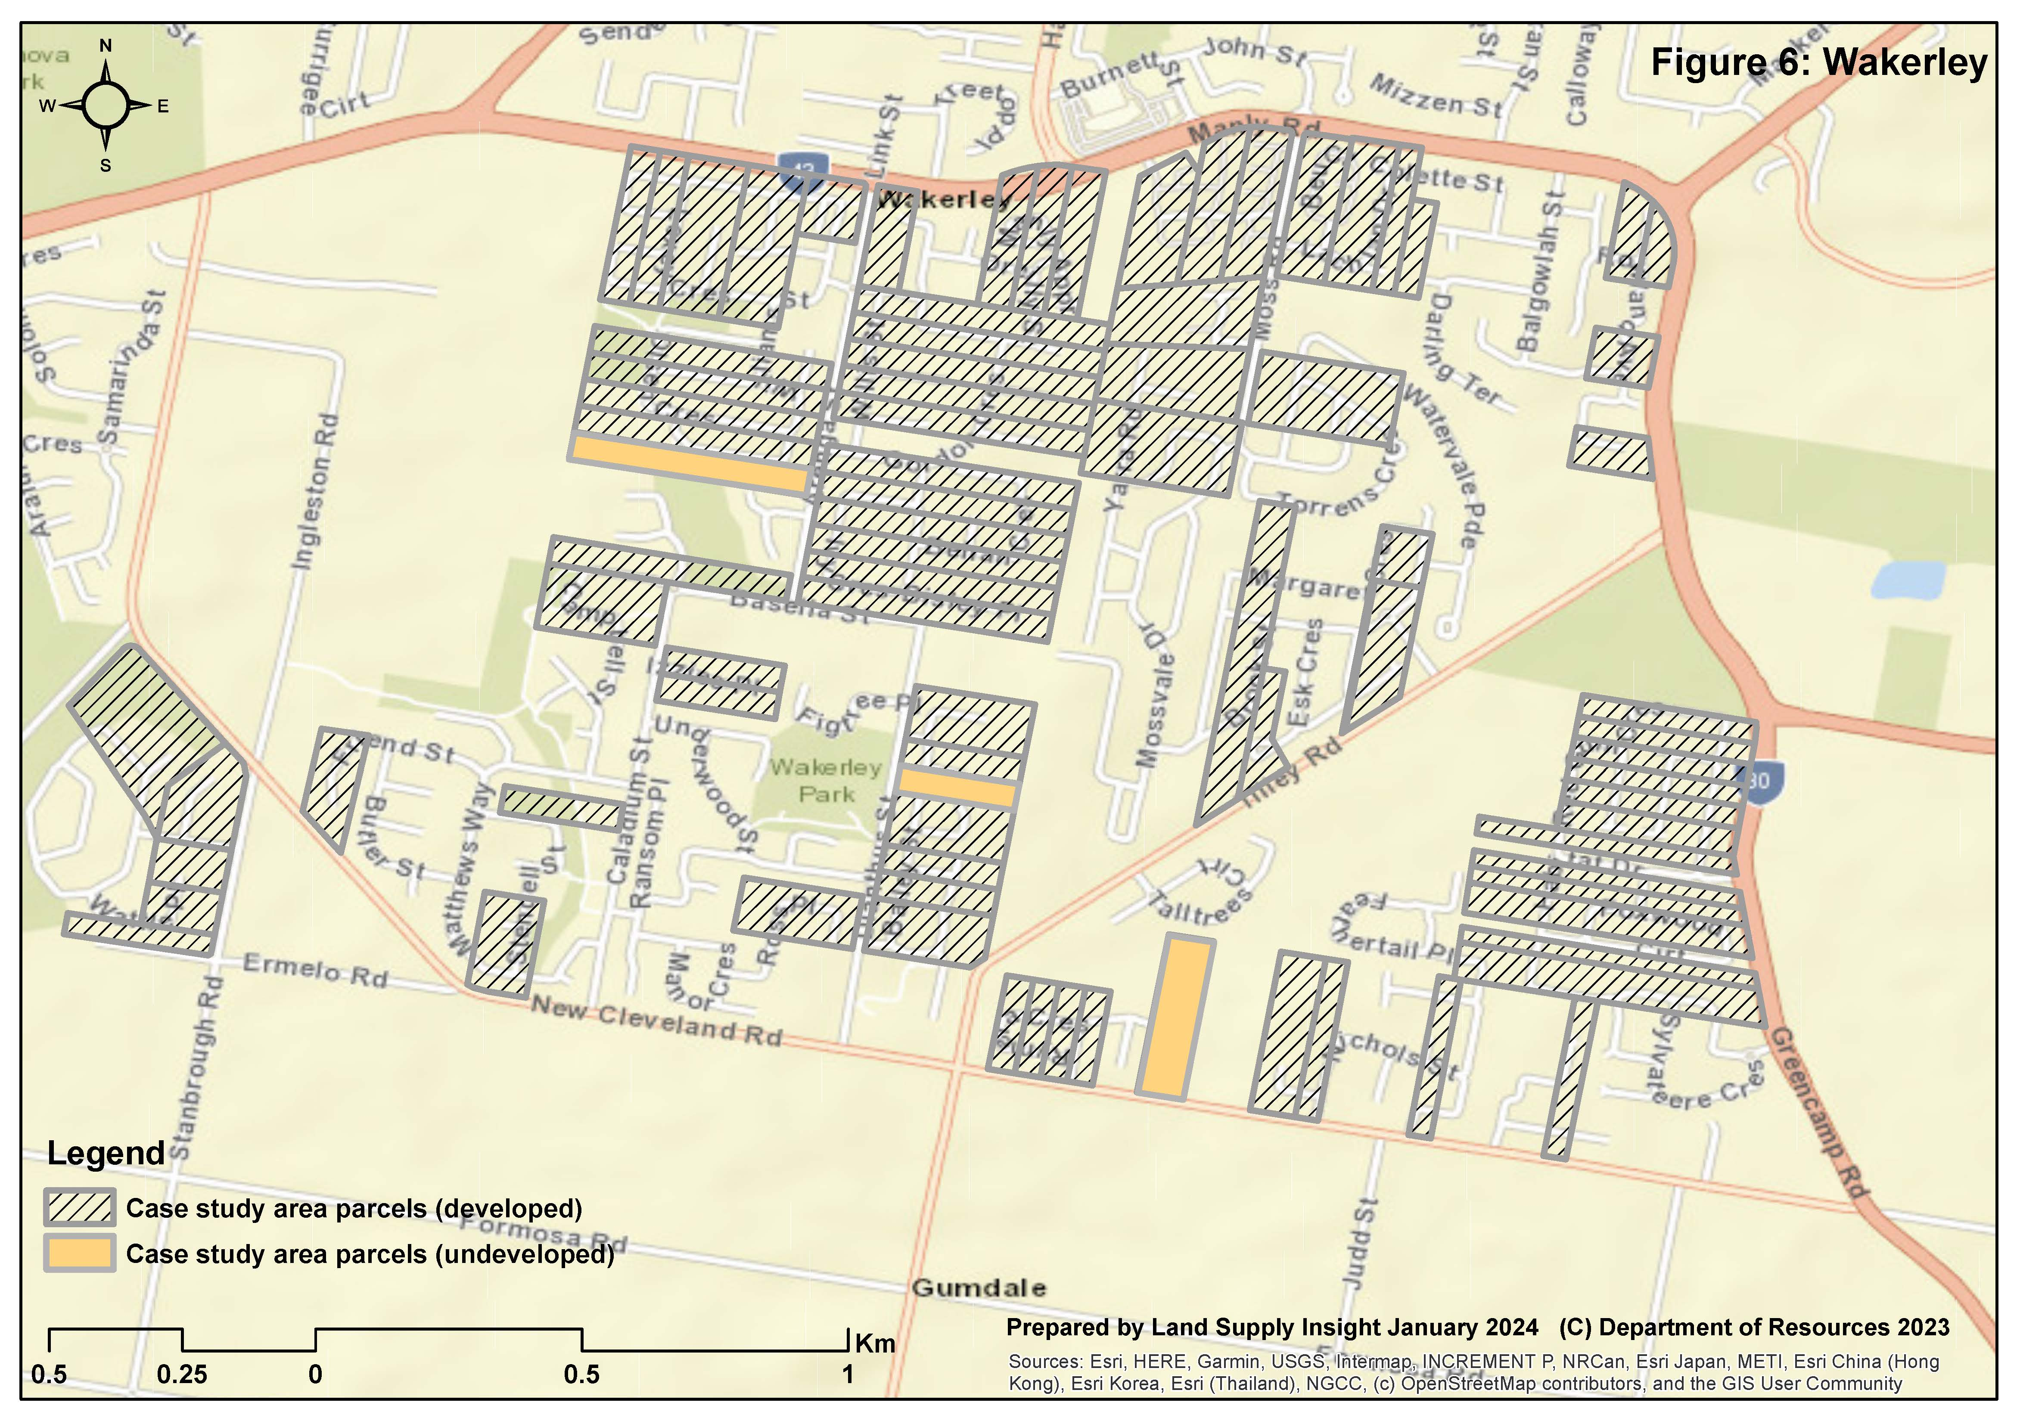
Wakerley
85 parcels (July 2001):
ave. title area 1.7 ha
ave. developable area 0.9 ha (of three undeveloped parcels)
96% developed
Infrastructure availability:
trunk sewer from Manly Rd to area key to motivate development
significant pockets of adjacent urban already existed in 2001
Development pattern:
local plan structure important
developer efforts in amalgamating smaller sites key to development
most urban lots created fairly rapidly over 10 years up to 2011

Slide 10
Findings
Key factors underpinning feasible development:
developable area
  90% plus development expected in long term where more than 0.5 ha per parcel
infrastructure feasibility
  higher developable area per parcel and overall supports funding of infrastructure
Other findings:
much slower rates of take-up expected for parcels with less than 0.5 ha developable area
less than 10% of pre-existing landowners likely not to sell to developers in the long term
development of some areas might need to be facilitated, e.g.
  catalytic funding of infrastructure
  planned density increases (or reduced constraints to increase developable area)

Slide 11
Conclusions for measurement of supply
realistic availability may be best indicated ahead of actual development by development permit or infrastructure agreement
PIA provides no basis for assessing realistic availability:
  provision of infrastructure within the PIA may be delayed by many years
  development often proceeds outside the PIA with augmentations
  individual project/site assessments commonly required to determine infrastructure feasibility
applications and developer ownership less useful indicators:
  may be significant delays in approval, e.g. while infrastructure issues resolved
  developers often apply under options contract (take ownership once approval secured)

Slide 12
Thank you for your attention.
Further details on this and other research into land and housing supply are available at:
https://www.landsupplyinsight.com.au/insights

